Slide 1
NEUROFLEETX AI POWERED URBAN FLEET AND TRAFFIC INTELLIGENCE
TEAM - D
TEAM MEMBERS :
K. Varshith Reddy
P. Navaroj Reddy
M. Revanth Reddy
Guide : Ms. Suchithra
Academic Year : 2025-26

Slide 2
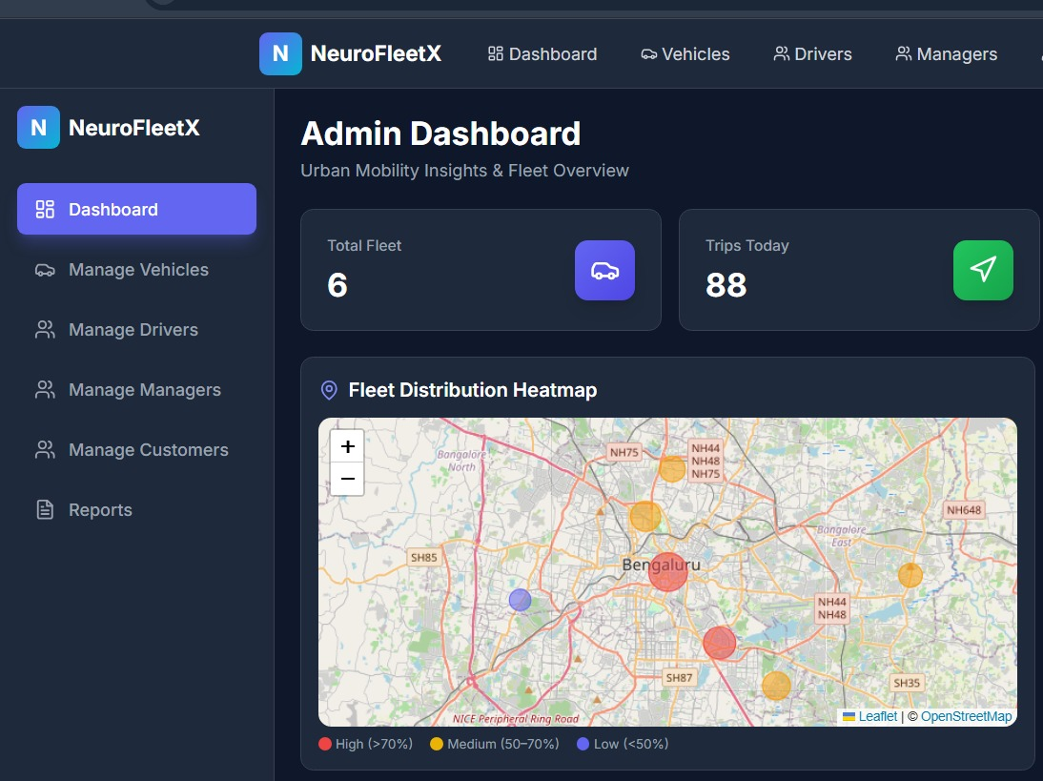
PROJECT OVERVIEW
NeuroFleetX is a smart fleet management platform designed to enhance efficiency and coordination in urban transportation through artificial intelligence and real-time tracking.
The system is developed using a Java Spring Boot microservices architecture, paired with a React-based frontend and MySQL databases. It incorporates AI-driven analytics to optimize traffic flow and operational performance.
By delivering real-time insights and improved transparency, NeuroFleetX enables better decision-making, boosts overall efficiency, and supports both managers and drivers with reliable, data-driven tools for smoother fleet operations.

Slide 3
KEY CHALLENGES IN URBAN MOBILITY
Ineffective Traffic Flow & Route Planning Without access to live traffic data, fleets experience frequent delays, increased fuel costs, and poorly optimized routes.
Insufficient Operational Visibility Operators lack a comprehensive, real-time view of vehicle positions, activity, and overall fleet performance.
Challenges in Workforce & Asset Coordination Dependence on manual processes makes it difficult to manage driver productivity, scheduling, and compliance efficiently.
Isolated Systems & Unconnected Data Disjointed tools for tracking, analytics, and reporting create data gaps, inconsistencies, and reduced operational effectiveness.

Slide 4
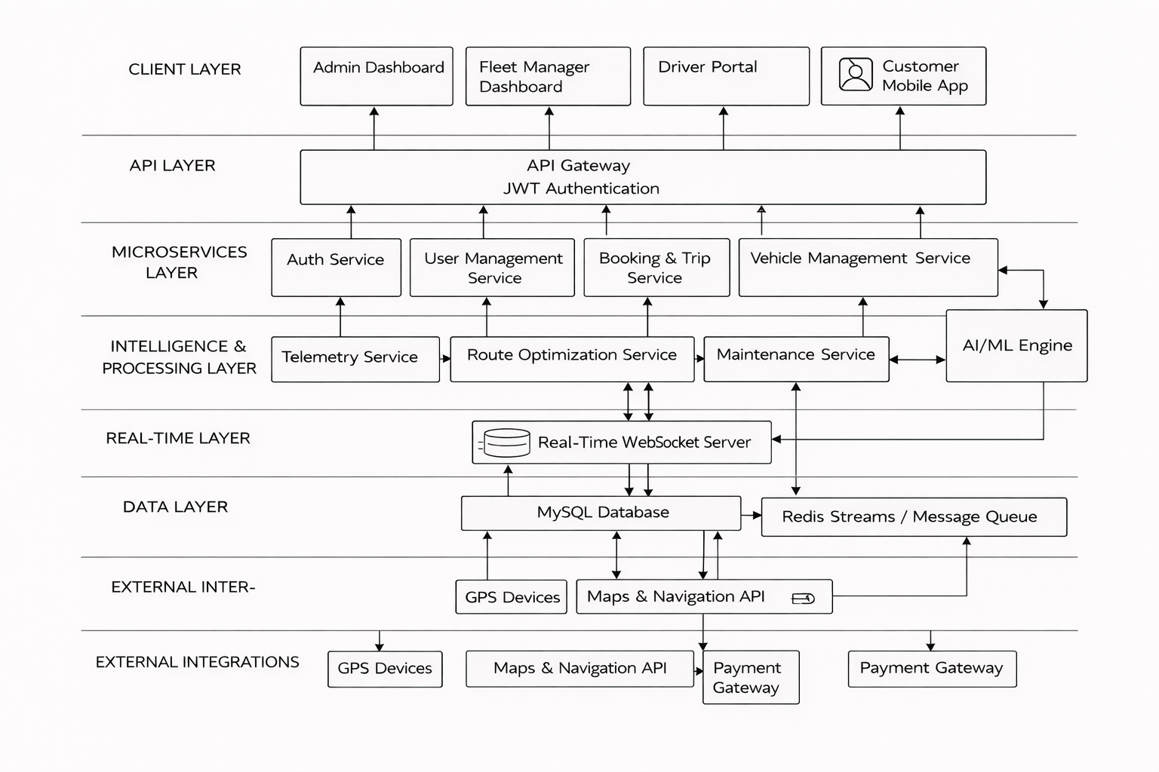

SYSTEM ARCHITECTURE AND FRAMEWORK

Slide 5
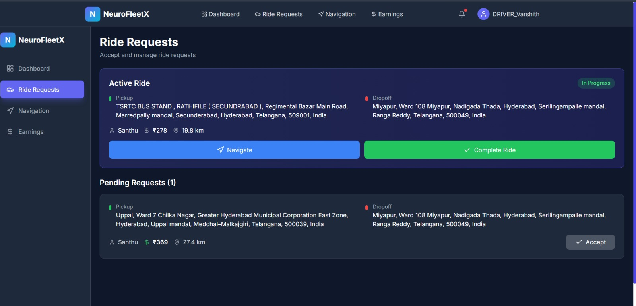
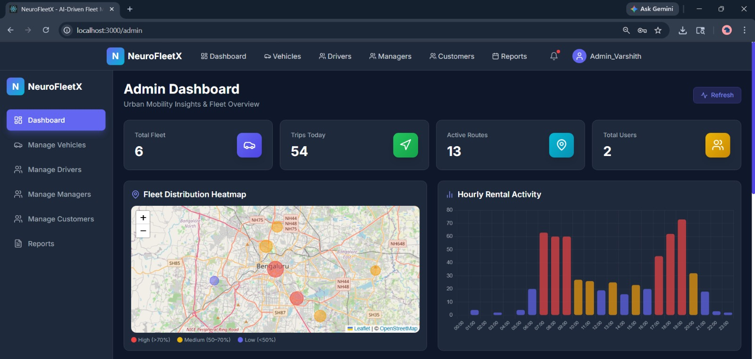
CORE SYSTEM MODULES
Fleet Operations Control Unified management of vehicles, drivers, task assignments, and live fleet status from a single platform.
Smart Routing & Navigation Intelligent, AI-based route planning that minimizes congestion, fuel consumption, and overall travel time.
Live Vehicle Monitoring Continuous tracking of vehicle positions and movement through GPS and real-time data streams.
Proactive Vehicle Maintenance Advanced analytics to identify potential issues early, prevent breakdowns, and streamline maintenance planning.

Slide 6
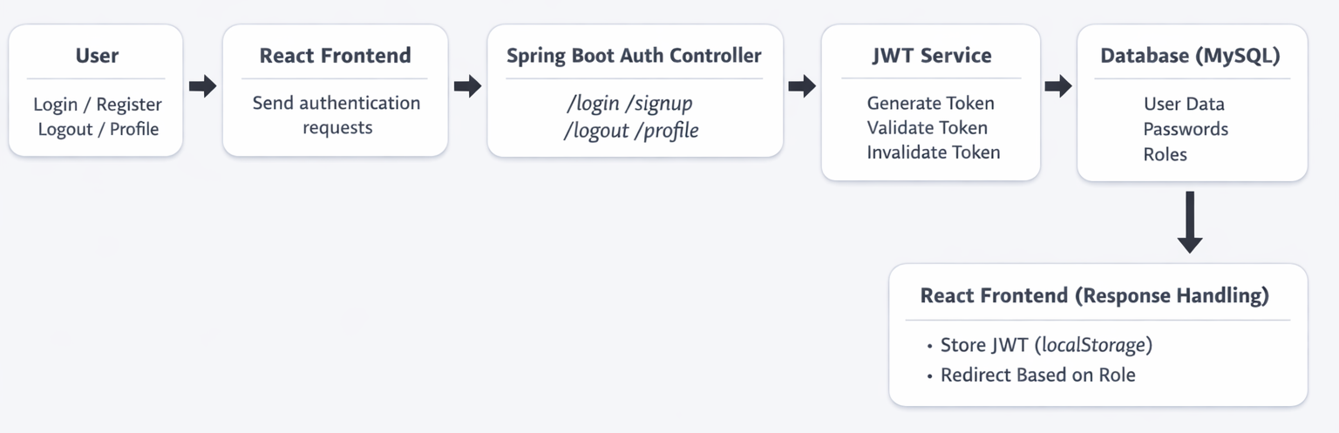
USER AUTHENTICATION MODULE
Key Highlights
Secure JWT-based authentication with configurable token expiry
Role-driven access control with dedicated dashboards
Efficient session handling with login and logout support
Safe authentication flow including signup, login, and profile access
Built on scalable microservices architecture
Main API Endpoints
POST /signup – Register new users
POST /login – Authenticate users
POST /logout – End user session
POST /profile – Retrieve user details
User Roles
Administrator
Fleet Manager
Driver
Customer

Slide 7
TECHNOLOGIES USED
Layer | Technologies
Frontend | React 18, React Router DOM, Axios, Vite, Tailwind CSS, PostCSS, Chart.js, react-chartjs-2, Recharts, Leaflet, react-leaflet, leaflet-routing-machine, leaflet-control-geocoder, lucide-react
Backend | Java 17, Spring Boot 3.2, Spring Web, Spring Data JPA, Spring Security, Spring Validation, JWT (jjwt), Lombok, Maven
Database | MySQL (configured with MySQL connector and MySQL dialect)
AI Service | Python, Flask, Flask-CORS, route optimization logic (distance-based calculations and multi-route generation)
Security | JWT authentication, Spring Security, CORS configuration
Dev Tools | Maven Wrapper, npm, Vite dev/build pipeline

Slide 8
MODULES AND SUB MODULES
Module 1 – Identity & Role-Based Access Control:
This module ensures secure login and role-based access for Administrator, Fleet Manager, Driver, and Customer users. It uses JWT authentication and encrypted passwords to protect user data and restrict access based on roles.
Module 2 – Fleet Registry & Live Telemetry:
This module manages vehicle data and enables real-time tracking of fleet activity. It provides visibility into vehicle status, movement, and health through GPS tracking and telemetry monitoring.
Module 3 – Intelligent Routing & Optimization:
This module calculates optimal routes using shortest-path and traffic-aware algorithms. It supports multiple route options, travel time estimation, and cost-efficient trip planning.
Module 4 – Predictive Maintenance & Health Monitoring:
This module monitors vehicle health in real time and generates alerts for potential issues. It helps reduce breakdowns through proactive maintenance planning and performance analysis.
Module 5 – Booking Management & Ride Lifecycle:
This module handles the complete booking process from request to trip completion. It provides real-time ride tracking, availability checks, and transparent cost estimation.
Module 6 – Admin Dashboard & Operational Insights:
This module provides administrators with analytics, KPIs, and system-wide insights. It enables monitoring of fleet performance, user activity, revenue trends, and report generation.

Slide 9
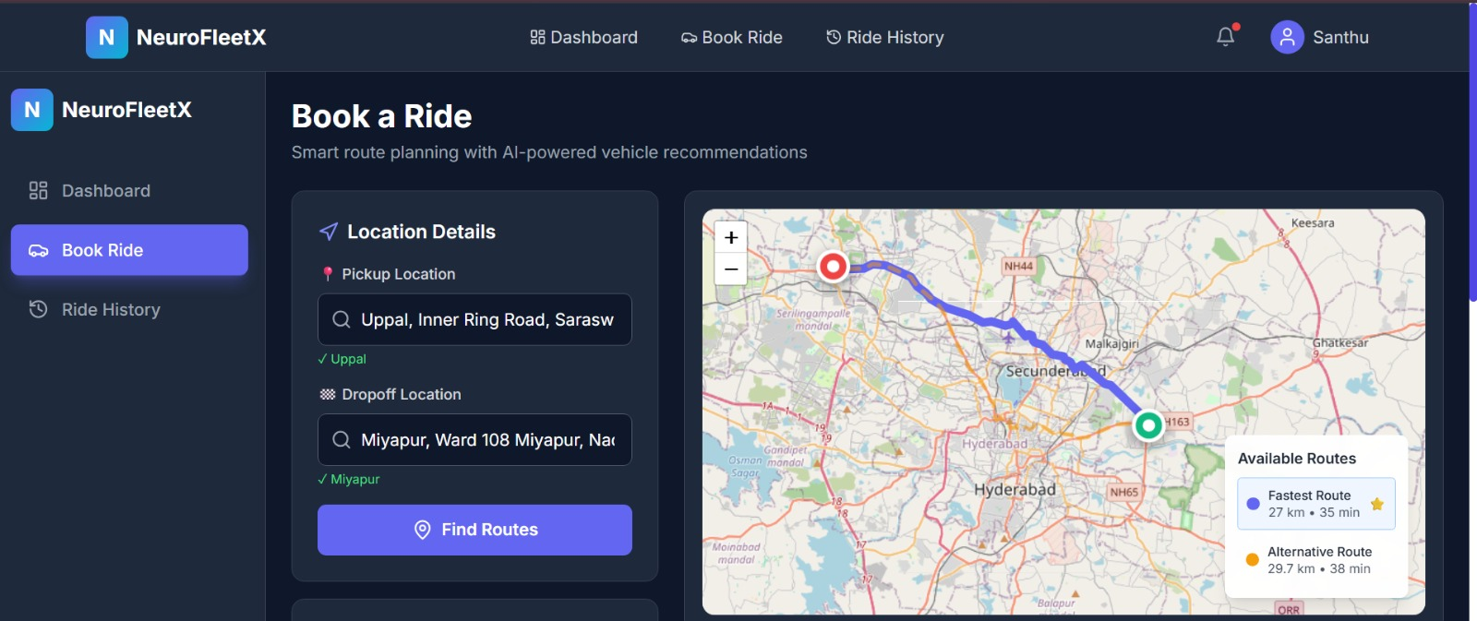
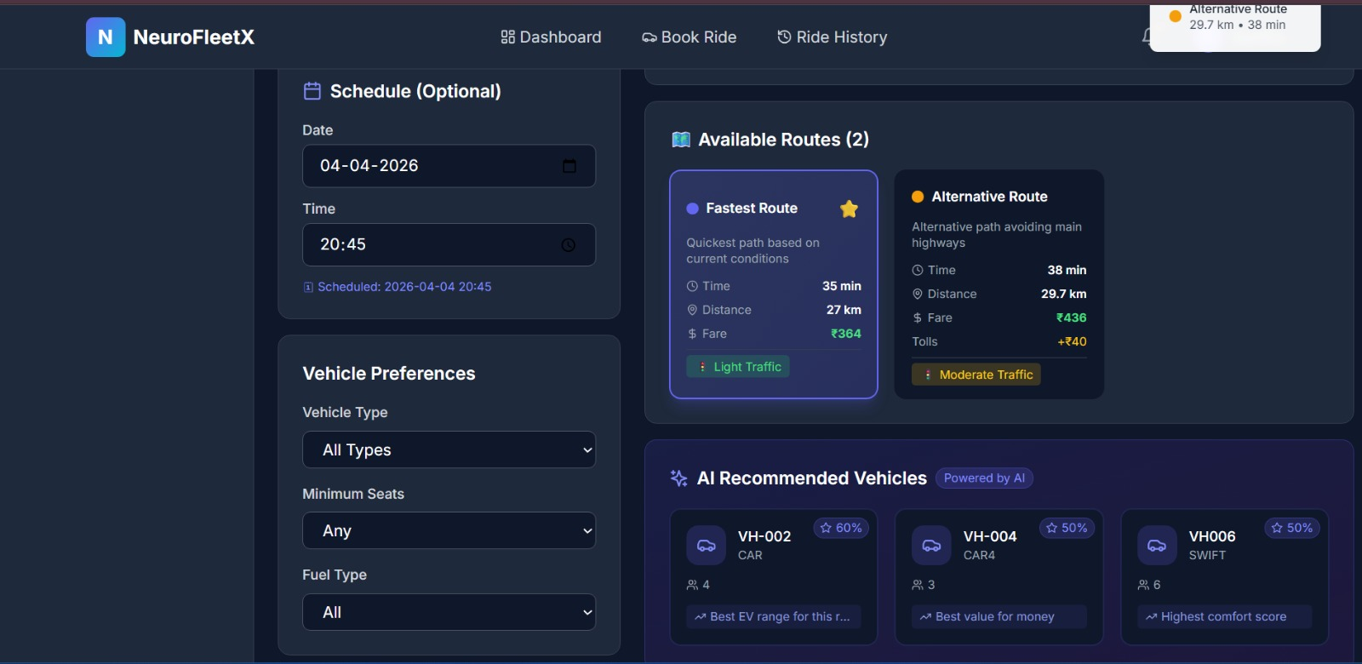
END TO END USER WORKFLOW
Trip Planning & Vehicle Selection Users can select routes, choose vehicles, and schedule time slots with intelligent recommendations.
Booking Confirmation & Trip Overview Immediate confirmation is provided along with detailed information about the trip, vehicle, and pricing.
User Dashboard Control A unified dashboard allows users to manage bookings, view routes, and track trip progress.
Real-Time Route Monitoring Interactive maps present optimized routes and live movement tracking for better visibility.

Slide 10
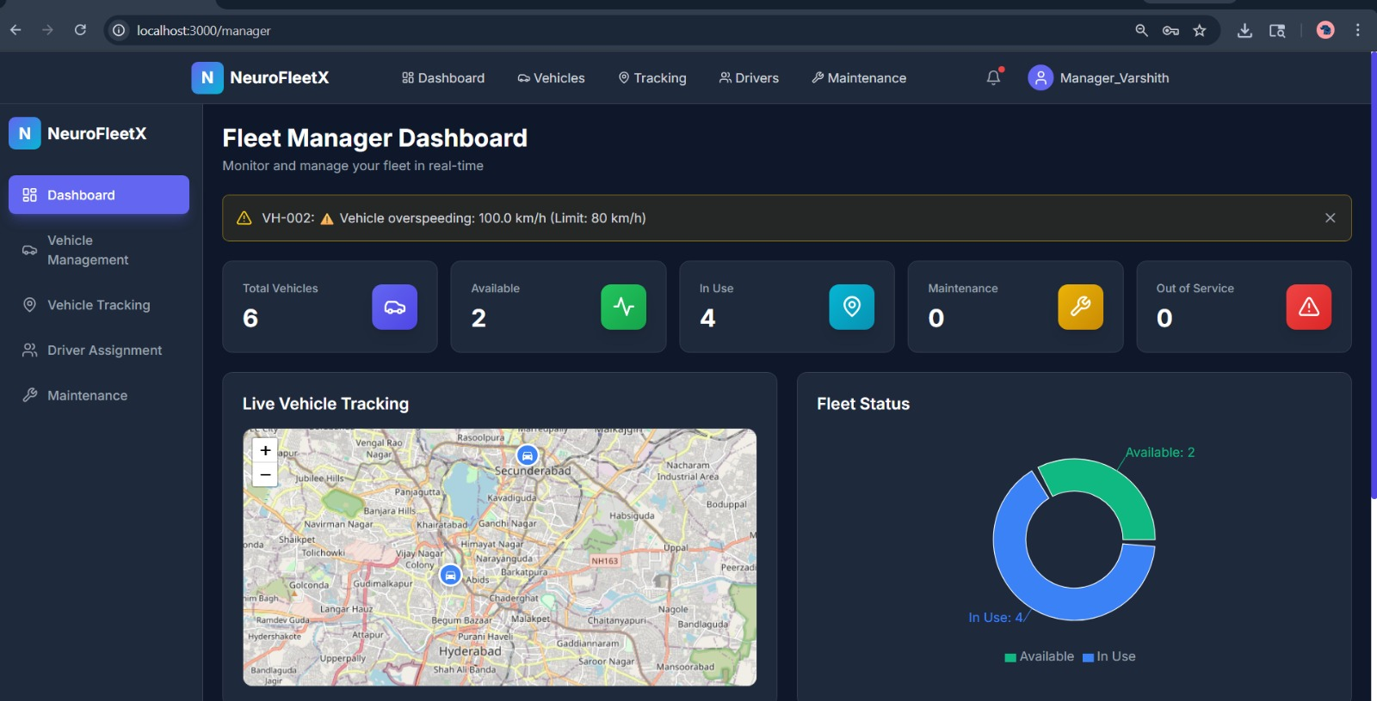
SMART ROUTING CONFIGURATION
AI Configuration Controls:
Flexible AI settings that allow routing behavior to adapt in real time
Tunable model parameters for balancing traffic, distance, cost, and efficiency
Real-time route adjustments based on congestion, incidents, and live conditions
Secure API connectivity for continuous data synchronization
Optimization controls to align routing performance with operational objectives

Slide 11

PROJECT IMPACT AND OUTCOME
Smarter Decision-Making Real-time analytics and performance insights enable fleet managers to make quicker, data-informed operational decisions.
Greater Fleet Visibility Live tracking and centralized dashboards offer full transparency into vehicle locations, routes, and overall fleet activity.
Lower Operational Expenses AI-powered route optimization reduces fuel usage, travel time, and unnecessary vehicle deployment, cutting overall costs.
NeuroFleetX enhances fleet operations through intelligent routing, real-time insights, and data-driven efficiency.

Slide 12
THANK YOU FOR YOUR TIME
Any Questions or Feedback?

